Slide 1
COT5615: Math for Intelligent Systems I
Anand Rangarajan
Lecture 29

Slide 2
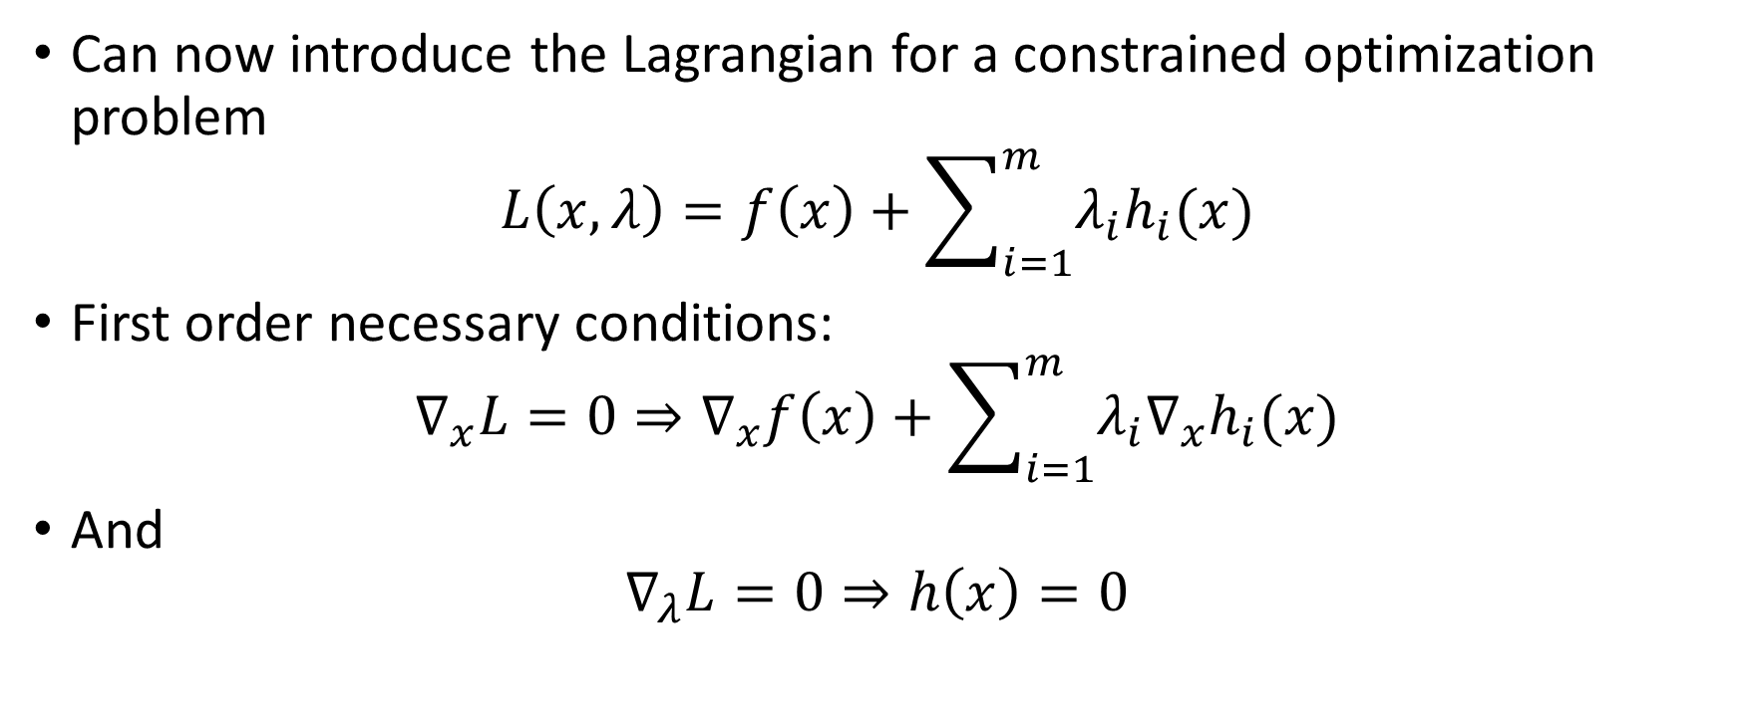
The Lagrangian
Can now introduce the Lagrangian for a constrained optimization problem
$$L\left(x,λ\right)=f\left(x\right)+\sum_{i=1}^{m}{λ_{i}h_{i}(x)}$$
First order necessary conditions:
$$∇_{x}L=0⇒∇_{x}f\left(x\right)+\sum_{i=1}^{m}{λ_{i}{∇_{x}h}_{i}(x)}$$
And
$$∇_{λ}L=0⇒h\left(x\right)=0$$

Slide 3
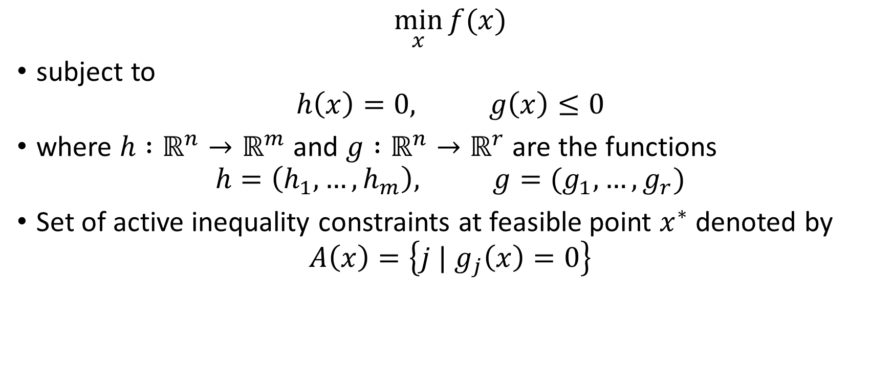
Inequality Constraints
$$\min_{x}{f(x)}$$
subject to
$$h\left(x\right)=0, g\left(x\right)≤0$$
where $h :ℝ^{n}→ℝ^{m}$ and $g :ℝ^{n}→ℝ^{r}$ are the functions
$$h=\left(h_{1},…,h_{m}\right), g=(g_{1},…,g_{r})$$
Set of active inequality constraints at feasible point $x^{∗}$ denoted by
$$A\left(x\right)=\left\{j | g_{j}\left(x\right)=0\right\}$$

Slide 4








Single inequality constraint
$$∇f(x)$$
$$x_{A}$$
$$x_{B}$$
$$∇f+λ∇g_{1}=0$$
$$∇g_{1}(x)$$
$$λ≥0$$
$$g_{1}\left(x\right)>0$$
$$g_{1}\left(x\right)=0$$

Slide 5
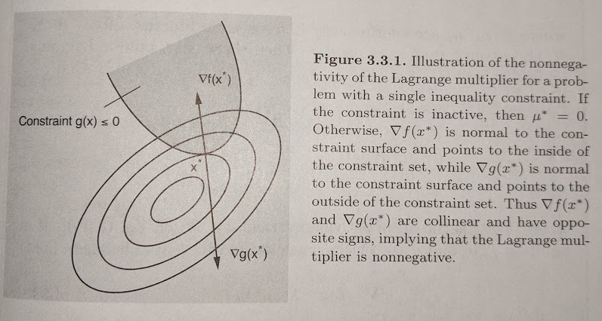
Single Inequality Constraint (contd.)

Slide 6
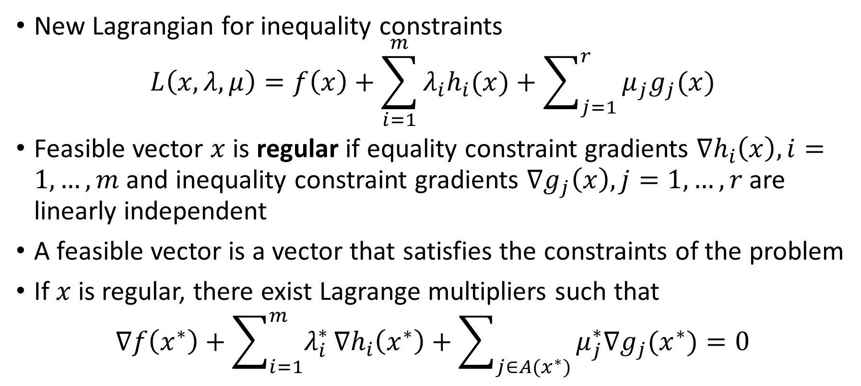
The Lagrangian (for inequality constraints)
New Lagrangian for inequality constraints
$$L\left(x,λ,μ\right)=f\left(x\right)+\sum_{i=1}^{m}{λ_{i}h_{i}(x)}+\sum_{j=1}^{r}{μ_{j}g_{j}(x)}$$
Feasible vector $x$ is regular if equality constraint gradients $∇h_{i}\left(x\right),i=1,…,m$ and inequality constraint gradients $∇g_{j}\left(x\right),j=1,…,r$ are linearly independent
A feasible vector is a vector that satisfies the constraints of the problem
If $x$ is regular, there exist Lagrange multipliers such that
$$∇f\left(x^{∗}\right)+\sum_{i=1}^{m}{λ_{i}^{∗}}∇h_{i}\left(x^{∗}\right)+\sum_{j∈A(x^{∗})}{μ_{j}^{∗}∇g_{j}(x^{∗})}=0$$

Slide 7
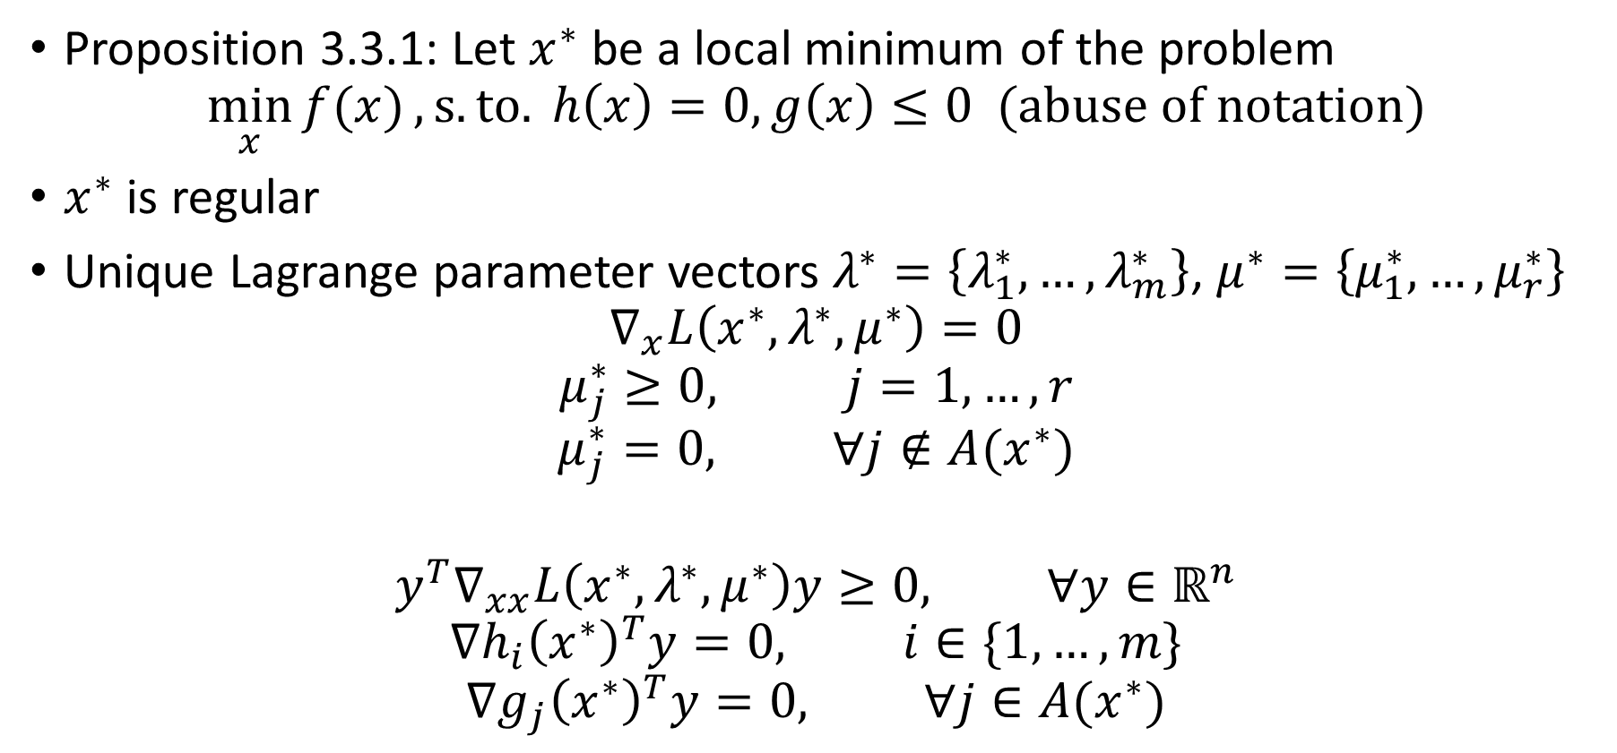
Karush-Kuhn-Tucker (KKT) necessary conditions
Proposition 3.3.1: Let $x^{∗}$ be a local minimum of the problem
$$\min_{x}{f(x)}, s.to. h\left(x\right)=0, g\left(x\right)≤0 (abuse of notation)$$
$x^{∗}$ is regular
Unique Lagrange parameter vectors $λ^{∗}=\left\{λ_{1}^{∗},…,λ_{m}^{∗}\right\}$, $μ^{∗}=\left\{μ_{1}^{∗},…,μ_{r}^{∗}\right\}$
$$∇_{x}L\left(x^{∗},λ^{∗},μ^{∗}\right)=0$$
$$μ_{j}^{∗}≥0, j=1,…,r$$
$$μ_{j}^{∗}=0, ∀j∉A(x^{∗})$$
$$y^{T}∇_{xx}L\left(x^{∗},λ^{∗},μ^{∗}\right)y≥0, ∀y∈ℝ^{n}$$
$$∇h_{i}{\left(x^{∗}\right)}^{T}y=0, i∈\{1,…,m\}$$
$$∇g_{j}{\left(x^{∗}\right)}^{T}y=0, ∀j∈A(x^{∗})$$

Slide 8
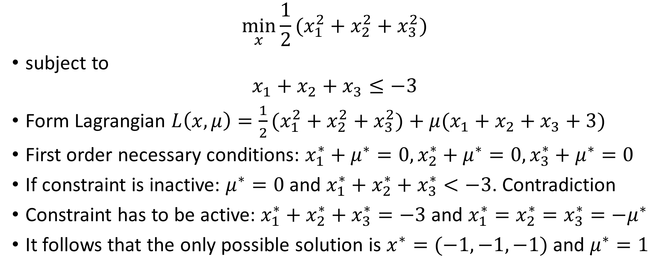
Example 3.3.1
$$\min_{x}{\frac{1}{2}(x_{1}^{2}}+x_{2}^{2}+x_{3}^{2})$$
subject to
$$x_{1}+x_{2}+x_{3}≤−3$$
Form Lagrangian $L\left(x,μ\right)=\frac{1}{2}(x_{1}^{2}+x_{2}^{2}+x_{3}^{2})+μ(x_{1}+x_{2}+x_{3}+3)$
First order necessary conditions: $x_{1}^{∗}+μ^{∗}=0, x_{2}^{∗}+μ^{∗}=0, x_{3}^{∗}+μ^{∗}=0$
If constraint is inactive: $μ^{∗}=0$ and $x_{1}^{∗}+x_{2}^{∗}+x_{3}^{∗}<−3$. Contradiction
Constraint has to be active: $x_{1}^{∗}+x_{2}^{∗}+x_{3}^{∗}=−3$ and $x_{1}^{∗}=x_{2}^{∗}=x_{3}^{∗}=−μ^{∗}$
It follows that the only possible solution is $x^{∗}=(−1,−1,−1)$ and $μ^{∗}=1$

Slide 9






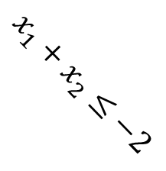
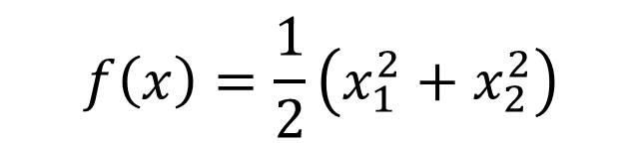
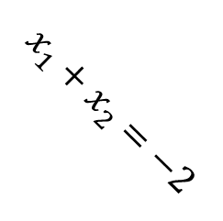

2D Version of Example 3.3.1
$$x_{2}$$
$$x_{1}+x_{2}=−2$$
$$f\left(x\right)=\frac{1}{2}\left(x_{1}^{2}+x_{2}^{2}\right)$$
$$x^{∗}=(−1,−1)$$
$$x_{1}^{2}+x_{2}^{2}=2$$
$$∇g(x^{∗})$$
$$x_{1}$$
$$∇f(x^{∗})$$
$$x_{1}+x_{2}≤−2$$

